Slide 1


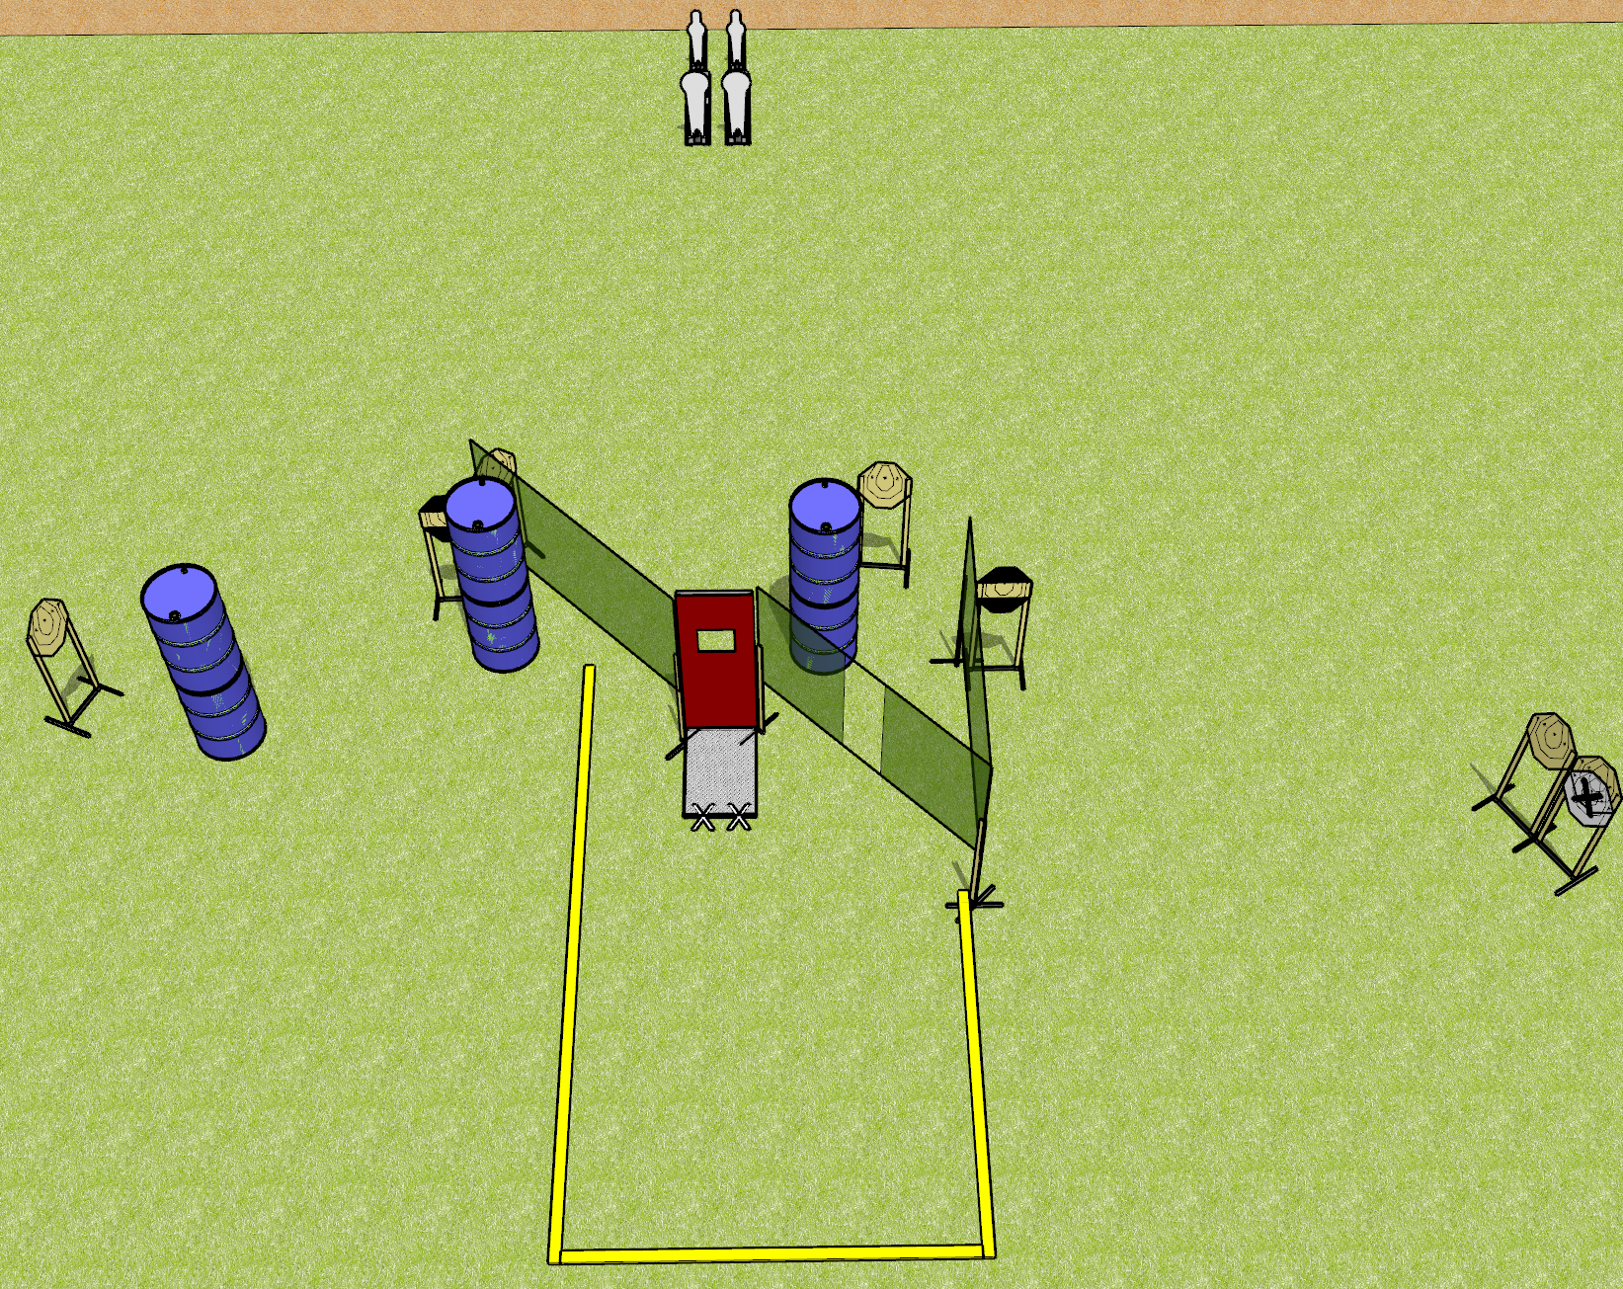
 | Dothan Gun Club – USPSA Match Despicable Course Designer : Drew Coleman
18 rounds 7 IPSC 2 Colt poppers, 2 mini poppers
Equipment List 6 wall feet 1 pull port 2 horizontal hard cover

Slide 2
Despicable
Written Stage Briefing
Despicable is an 18 round, 90 point, Comstock course of fire. There are 6 IPSC targets, 2 colt poppers, and 2 mini poppers. The best 2 hits on paper will score, and steel must fall to score. The start signal is audible.
Window prop must be closed with pull cord hanging unsupported and untouched.
Handgun start position is toes on X’s, wrists below belt. Handgun is loaded and holstered.
PCC start position is toes on X’s. Loaded carbine is held with both hands, safety on.
On start signal, engage targets as they become available from within the shooting area.

